Slide 1

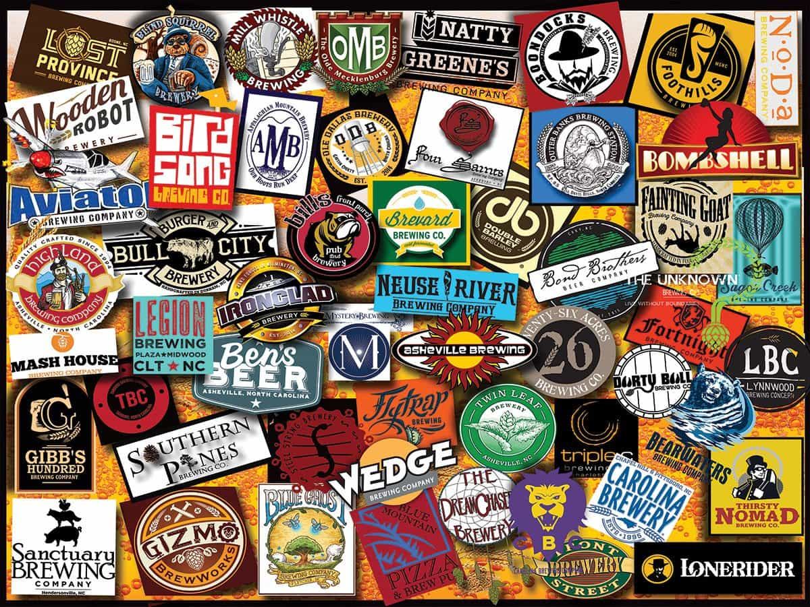
Carolina Brew
E.T.L Project
Melinda Eudy,
Kelly Rose, and
Darrius Summers

Slide 2

ETL Project Idea
Covid-19 has created a society with a bit of claustrophobia
What will people want to do now that states are opening back up?
Day trips? Weekend Trips?
Distance? North and South Carolina
Something new!
Result:
Bars in NC and SC
What are they rated?
How expensive?
Reviews?

Slide 3
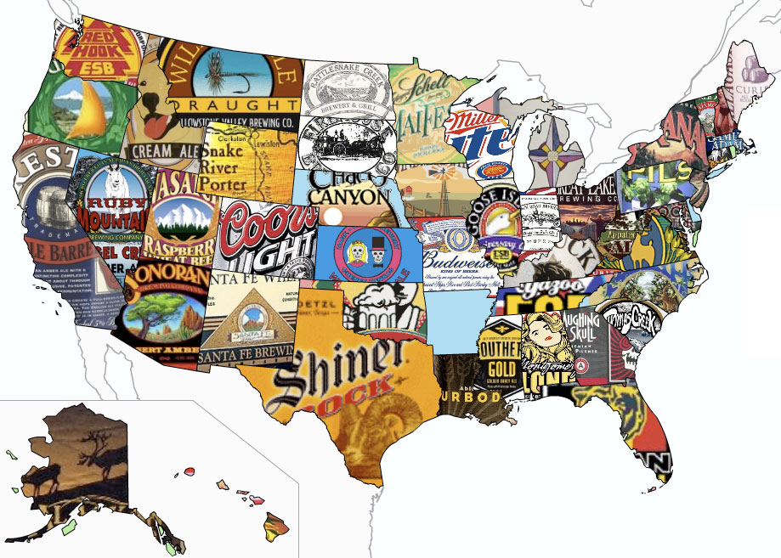
A Brewtastic Journey
In the beginning – 1700 BCE
First American Brewery – 1829
Originated in PA
Yuengling – “The oldest & Coldest”
Carolina Brew
NC – 1986 – currently houses 320 breweries “Top 10”
SC – 1800’s – currently houses 48 breweries

Slide 4
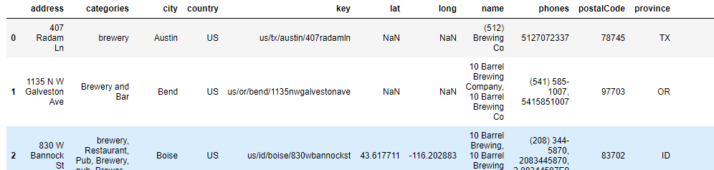
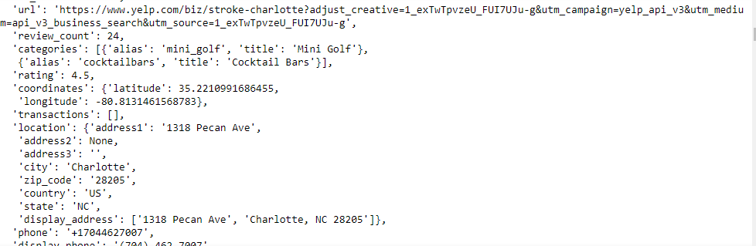
Extraction
Data sets:
KAGGLE - BREWERIES AND BEER PUBS IN THE US (.CSV)
'https://api.yelp.com/v3/businesses/search’ (NC)
'https://api.yelp.com/v3/businesses/search’ (SC)
Initial Files:

Slide 5
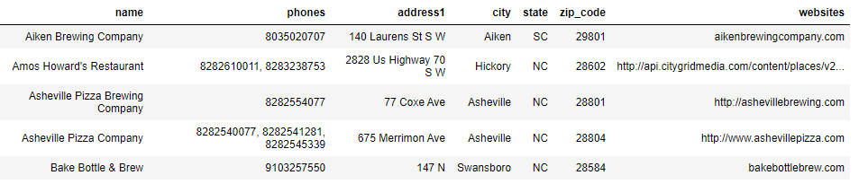
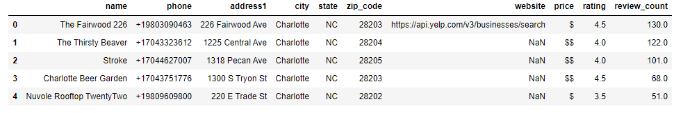
Transform
Kaggle file: remove columns, renamed columns, reorganized columns, removed rows with Nan and finally, sorted to North and South Carolina
Final Result: 77 Bars
Yelp file: created a list of rows of interest—address, bar id, price, rating, and number of reviews. Then placed into a pandas DataFrame.
Final Result : 20 Bars NC & 20 Bars SC

Slide 6
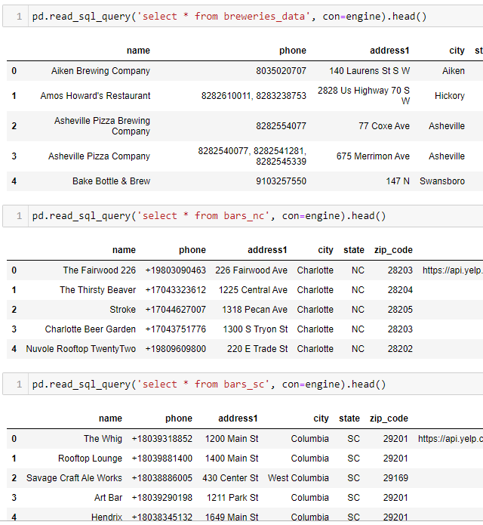
Transform
Sent tables to postgres – pgAdmin4
Confirmed all tables loaded

Slide 7

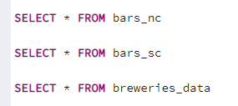
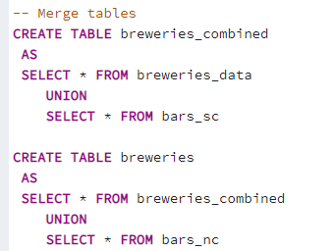
Transform
Altered Breweries_data by adding three columns
Confirmed tables were present in pgAdmin4
Merged tables to create one final table

Slide 8

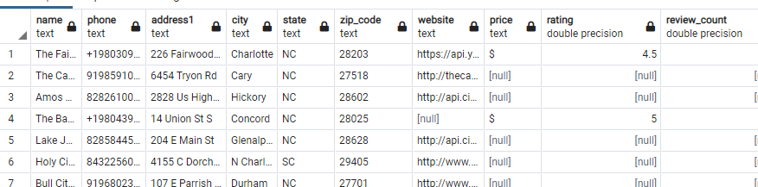
Load
Confirmed data in merged tables (FINAL TABLE: Breweries)
Confirmed size of table – 117 Rows

Slide 9
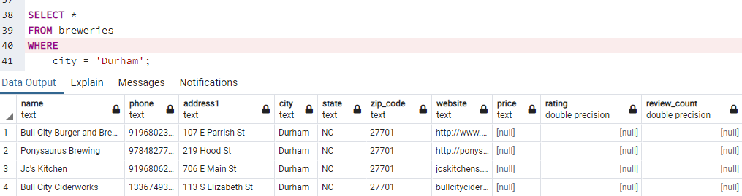
Test Case
Road Trip: Query for breweries in ‘Durham’

Slide 10
Conclusion
Extraction
Yelp API
Kaggle CSV file
Transform
Adjusted table columns
Established listed and rows
Merged tables in PgAdmin
Load
Confirmed merge and final table

Slide 11
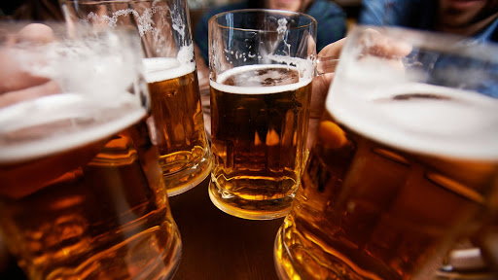
Q&A

